Slide 1



Evaluation criteria
Unsupervised learning
  No label, No SSE(Sum of Square Errors)
  Internal evaluation using clusters themselves
Silhouette coefficient
a : average distance between a random node in a cluster and other nodes in the cluster (Cohesion).
b : minimum value of the average distance between a random node in a cluster and other nodes in another cluster (Separation).

Slide 2
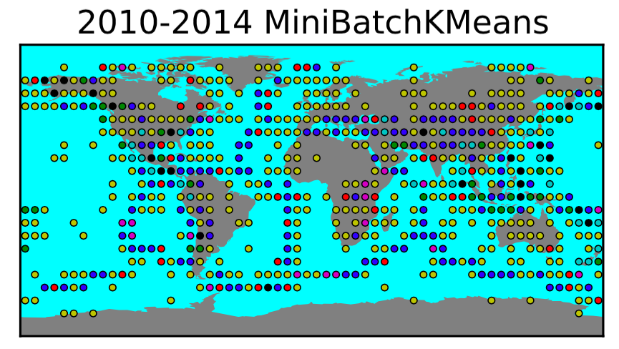
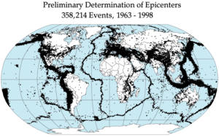
Clustering of earthquake freq.(1/2)

Slide 3
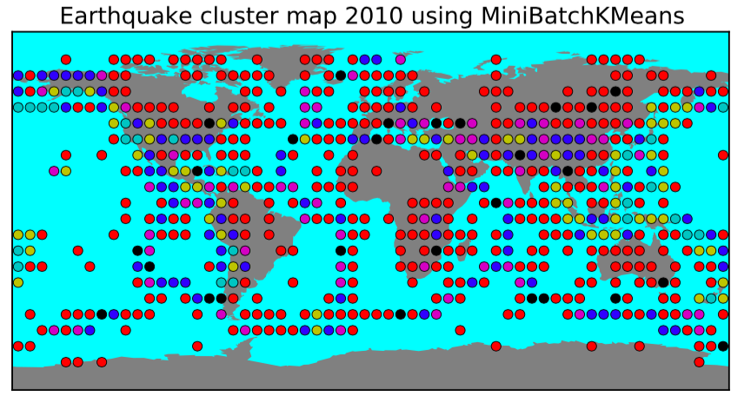
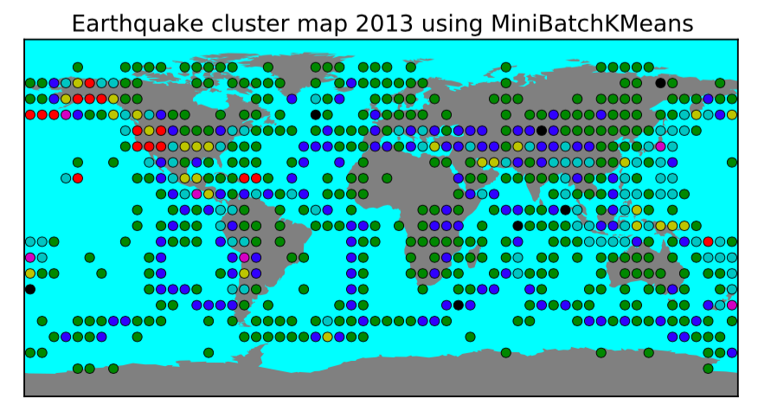
Clustering of earthquake freq.(2/2)

